Slide 1
P-0001396-T05-IM6/N01

Slide 2
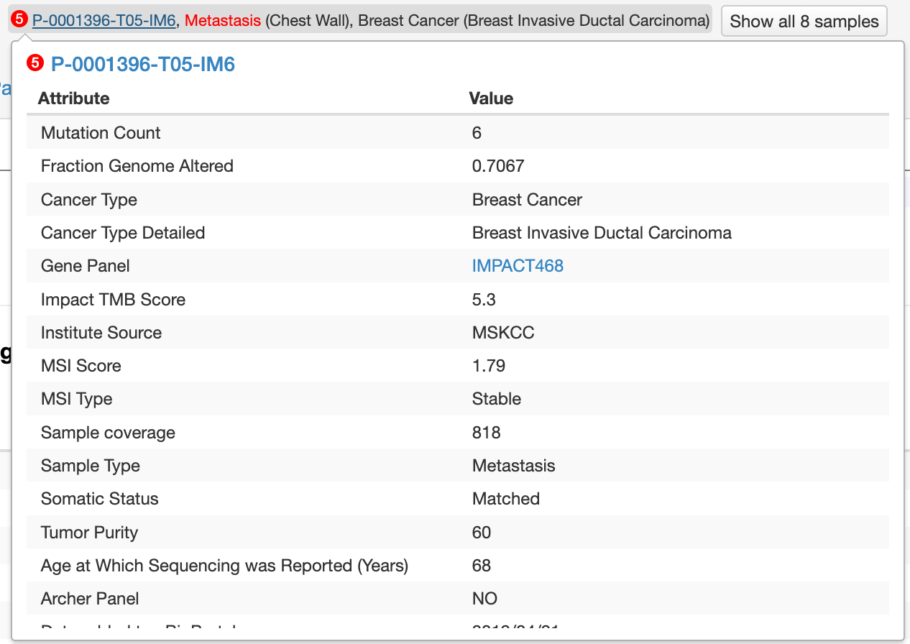
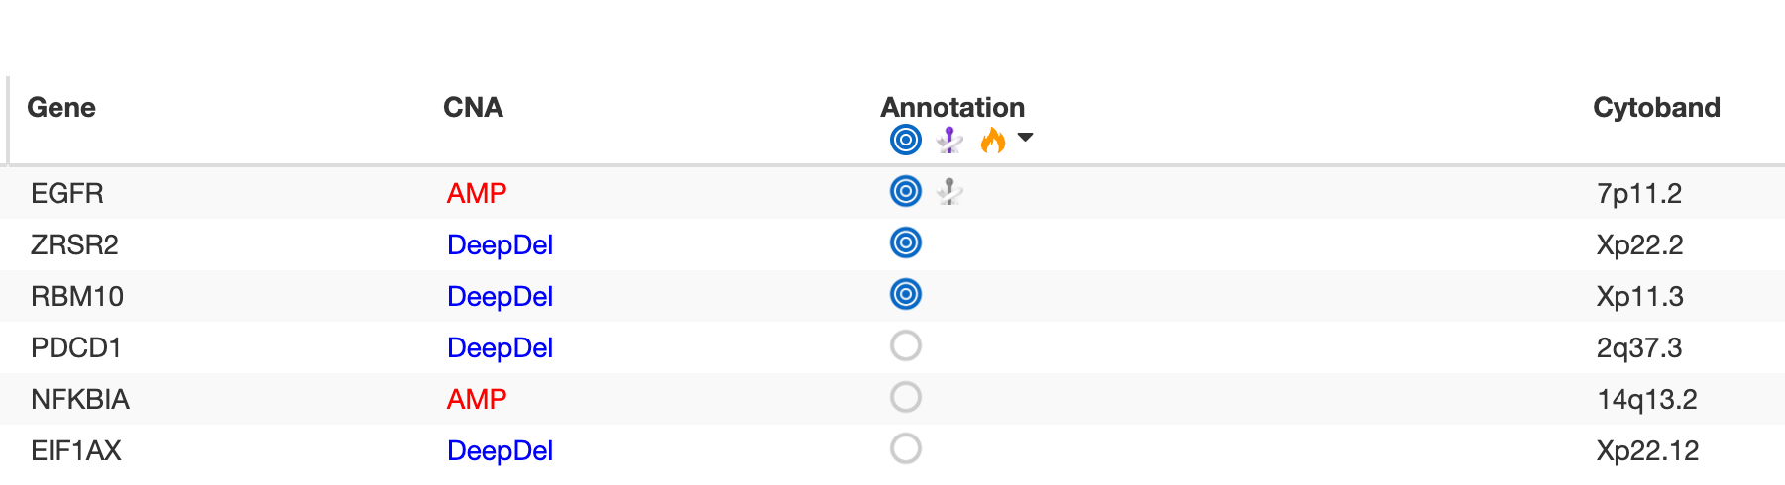
Characteristics
A case study to illustrate the main ideas behind dryclean
Female, 69 years, 89 months living
6 somatic copy number alterations reported

Slide 3
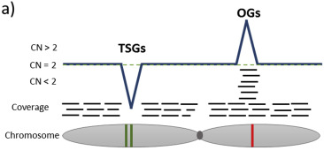
Assess the SCNA calls – without a ground truth
Premise: TRUE aberrations in the TUMOR can only be detected if we have a uniform coverage in the matched normal
Targeted approaches (IMPACT) further impede the uniformity – concentrated reads.
Current methods (GATK DepthOfCoverage tool == cbio calls, Facets) rely on matched normal samples to infer copy number changes
The problem: There is a lot of uneveness in the genome; ‘noise’, bias, GC content, replication timing, etc.
Figure adapted from Heitzer, Ellen et al (2016)

Slide 4
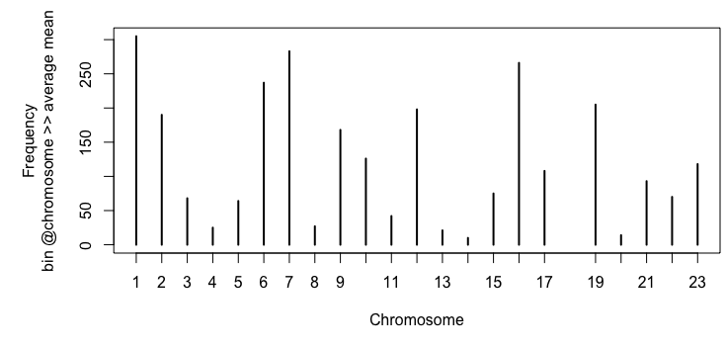
Looking into the ‘problem’ – looking into the whole population – NORMAL samples
1,000 BRCA samples
What we can see here is interesting:
On chromosome 1, there are > 250 bins
(defined in 1bp resolution) which are above the
99% quantile of average means.
That saying that there is a region,
or a gene or several segments which are overly
represented through the sequencing of the normal
samples (PON; n = 992).
Equally for chromosomes 6, 7 and 16.
Interestingly, chromosomes 14 and 18 seem to be
‘underrepresented’ or at least not conspicuous.
We could calculate this on a gene basis OR exon basis
or defined bin-basis. Right now: 1bp resolution
Elevated amount of regions where the coverage is >> population mean

Slide 5
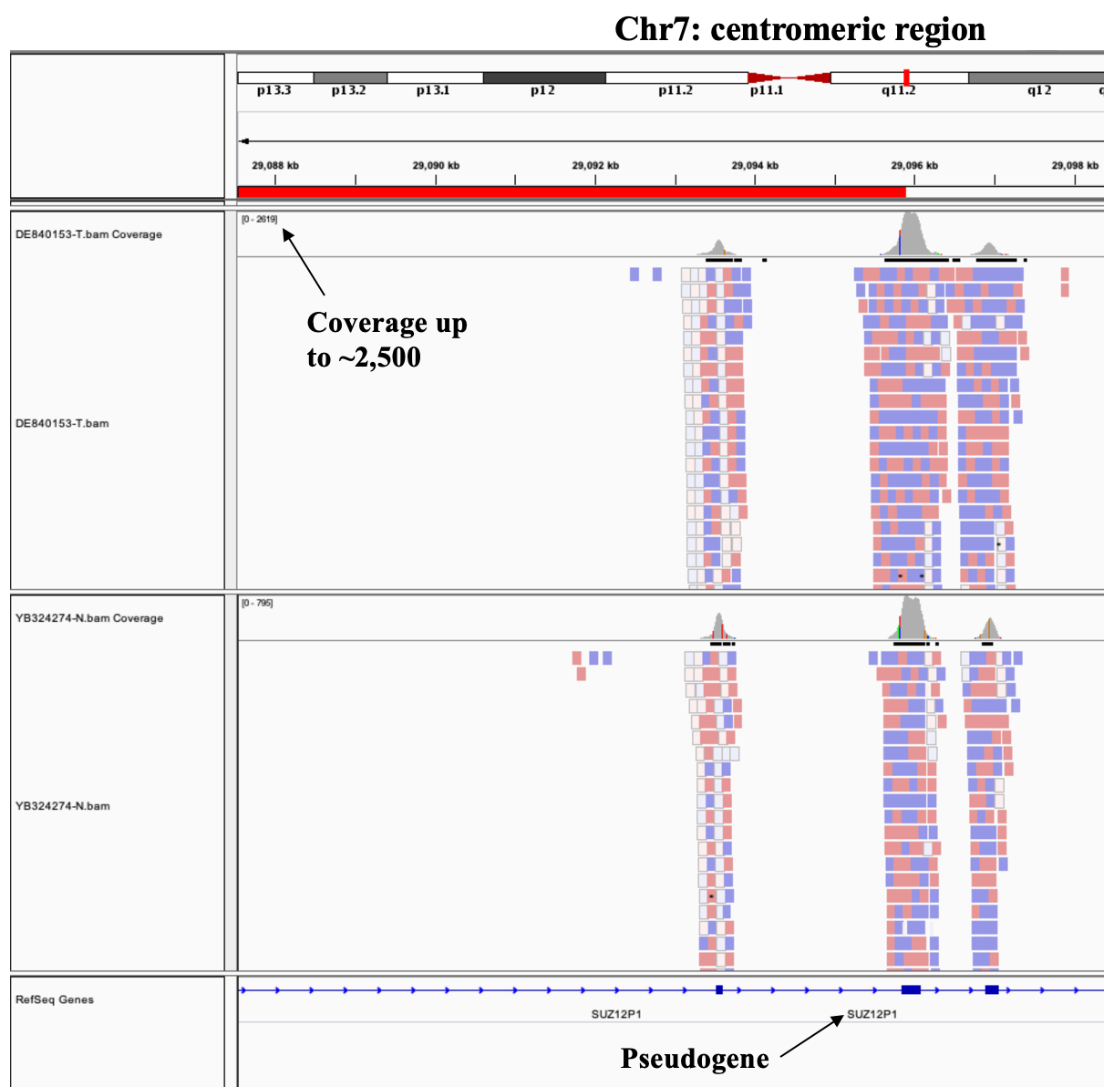
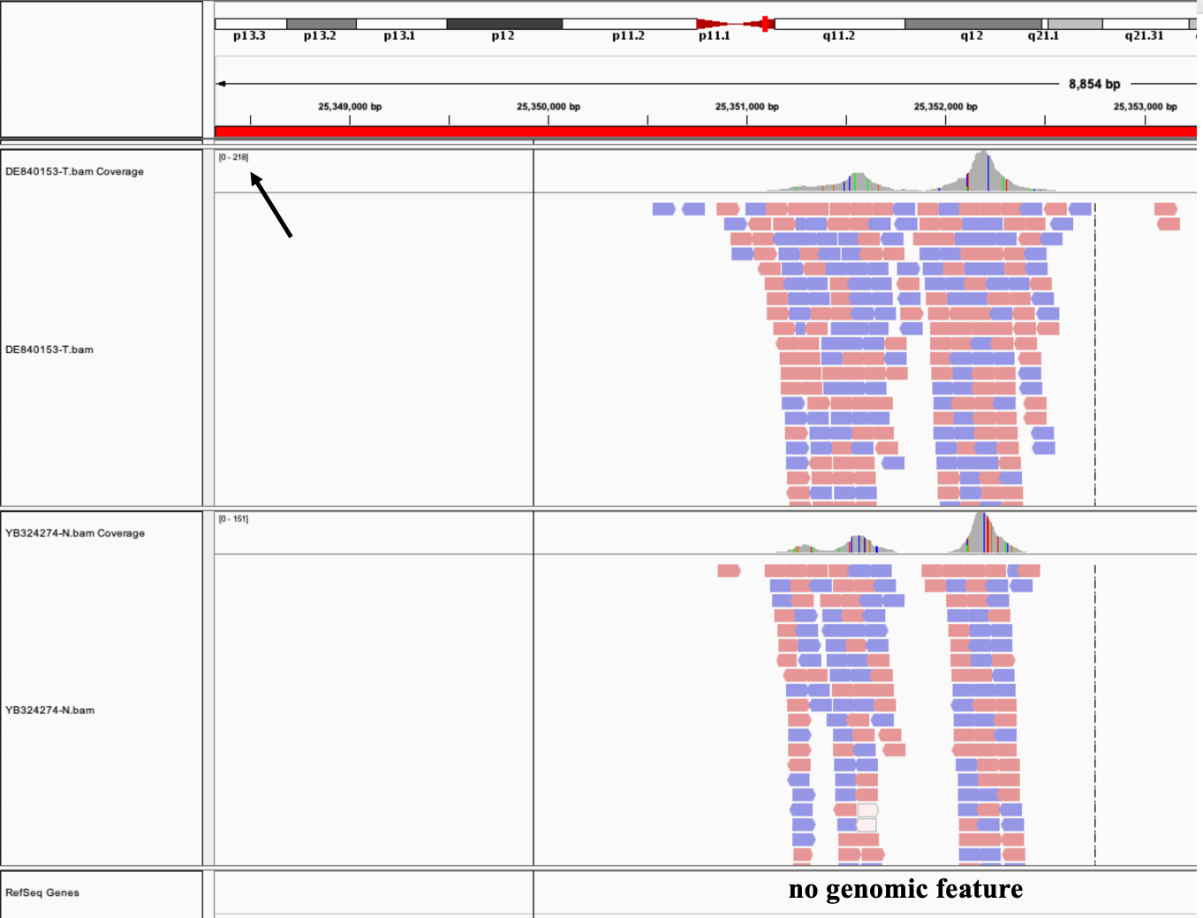
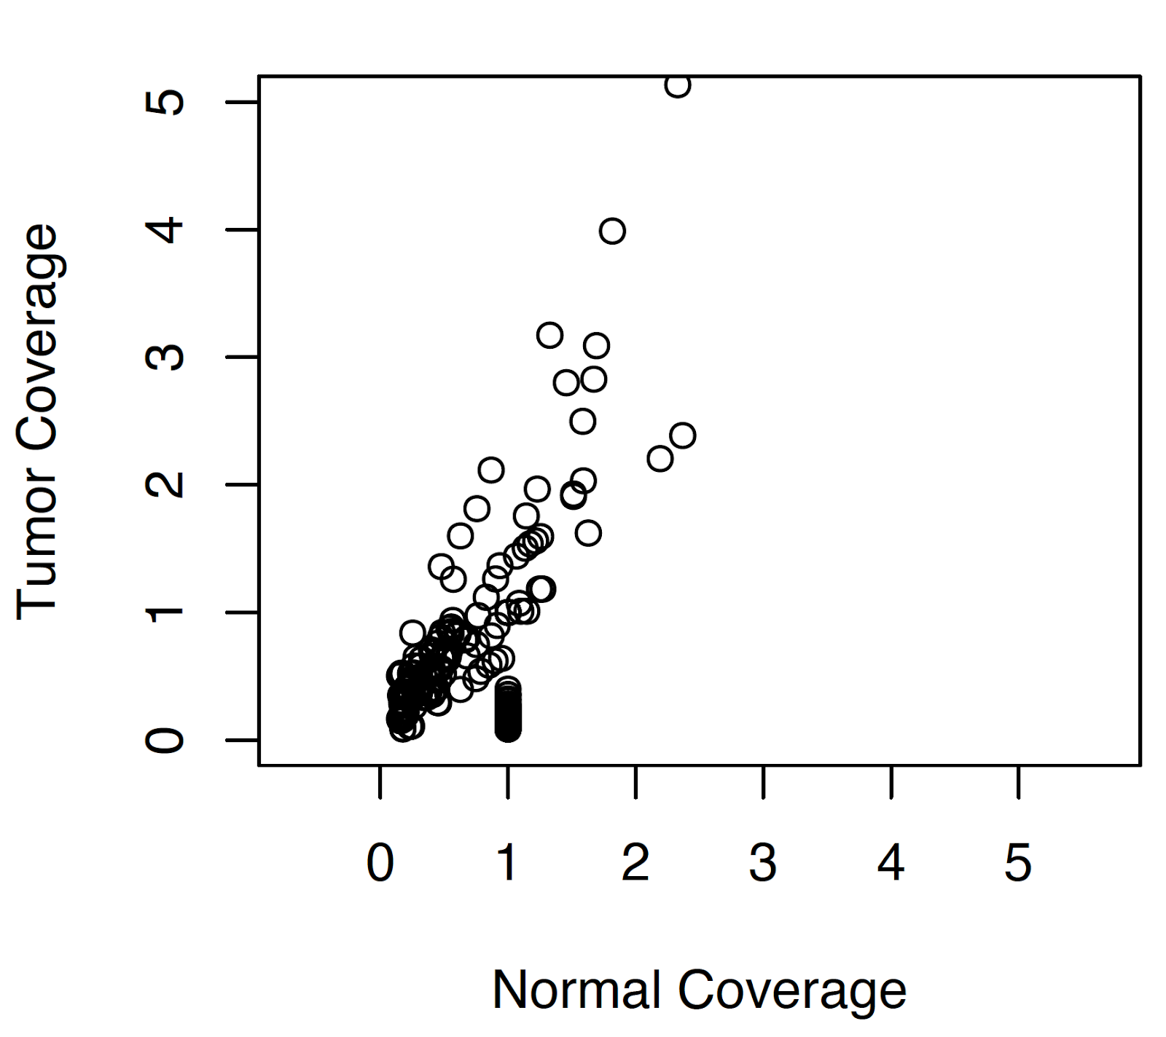
Since we are talking about P-0001396-T05-IM6
What about the uneven regions in this sample?
We see a total of 96 uneven regions – some targeting many important genes – some with no specific target – example below (hence I will denote this region as ‘noise’ to see whether we are filting those regions
There is a correlation between
tumor and normal
Either through contamination or
pseudogenes map to different loci

Slide 6
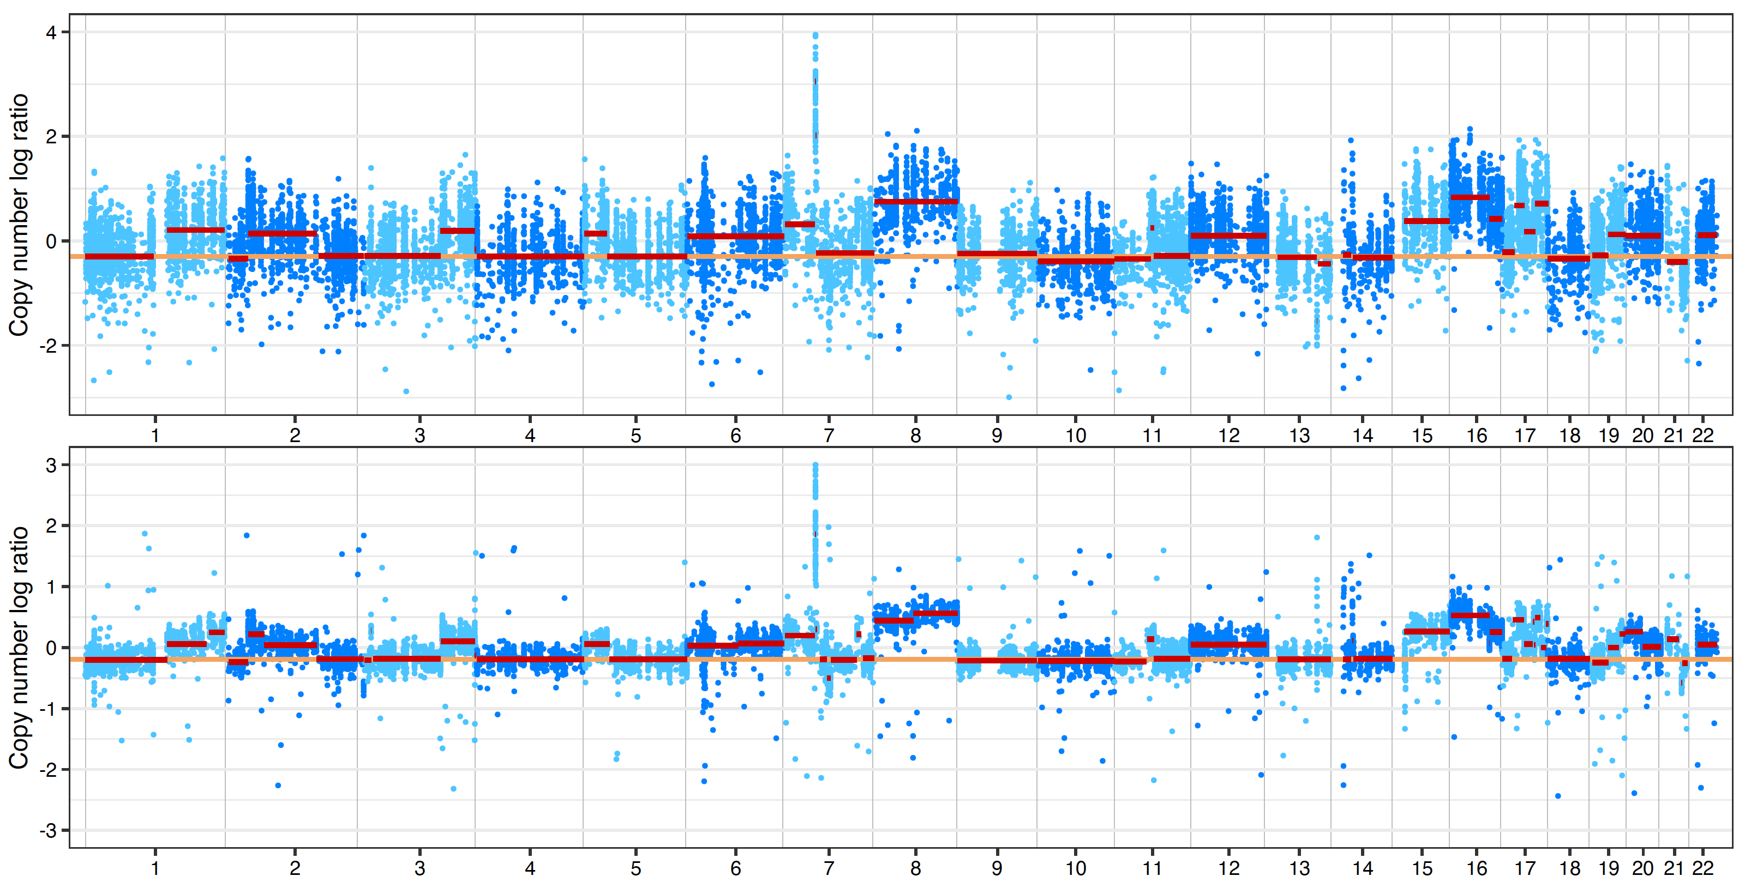
So the question is, can we filter out those regions?
Same parameter in both runs
We see a more granular view
in the modified version
Original Facets Algorithm
Cleaned Facets

Slide 7
Check individual genes: EGFR, PTEN, RBM10, PTEN

Slide 8
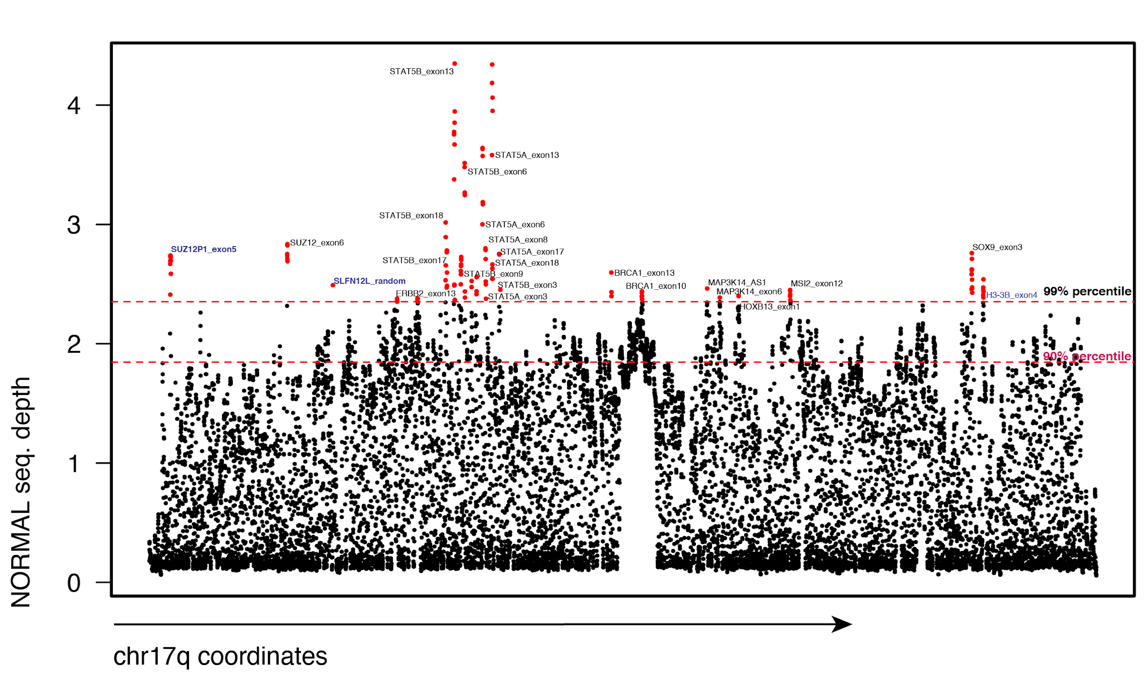
Systematic overrepresentation of certain bins in normal samples; Seq. coverage chr17q; a population average
Noise?
Noise?
Noise?
Chr17q: 26 targeted genes from IMPACT; 8 show elevated coverage

Slide 9
03/16/2022

Slide 10
Completing the runs with drycleaned-Facets

Slide 11
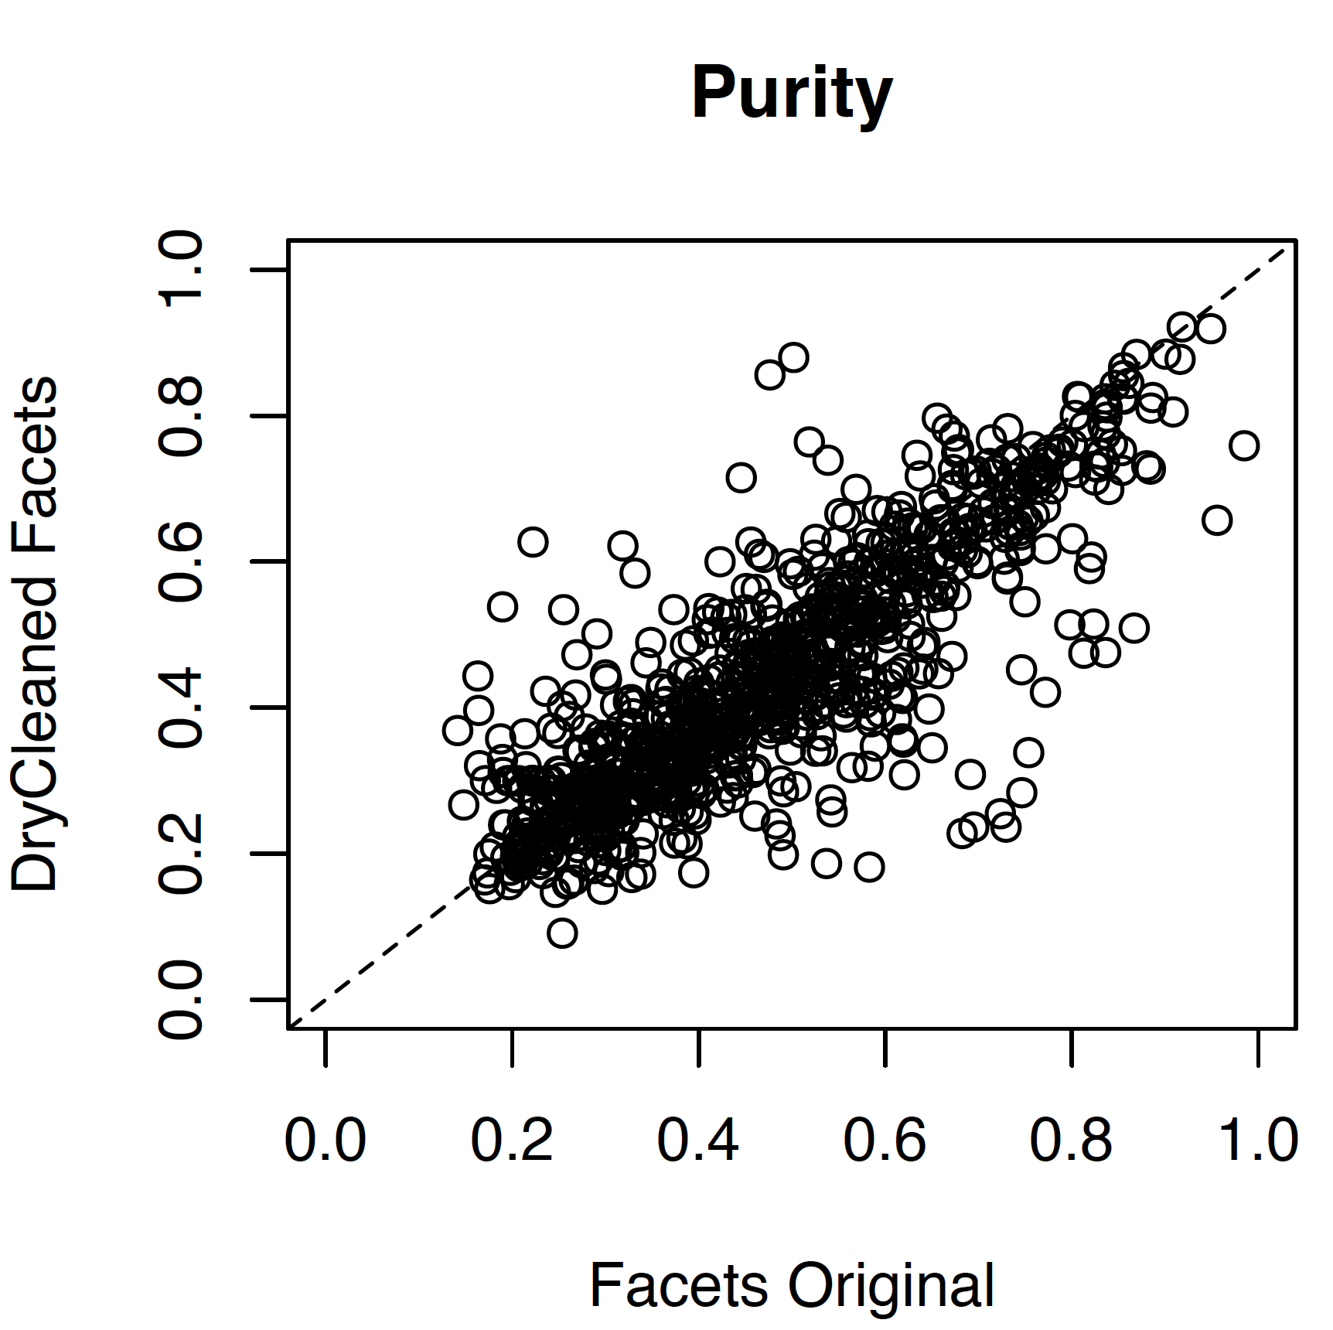
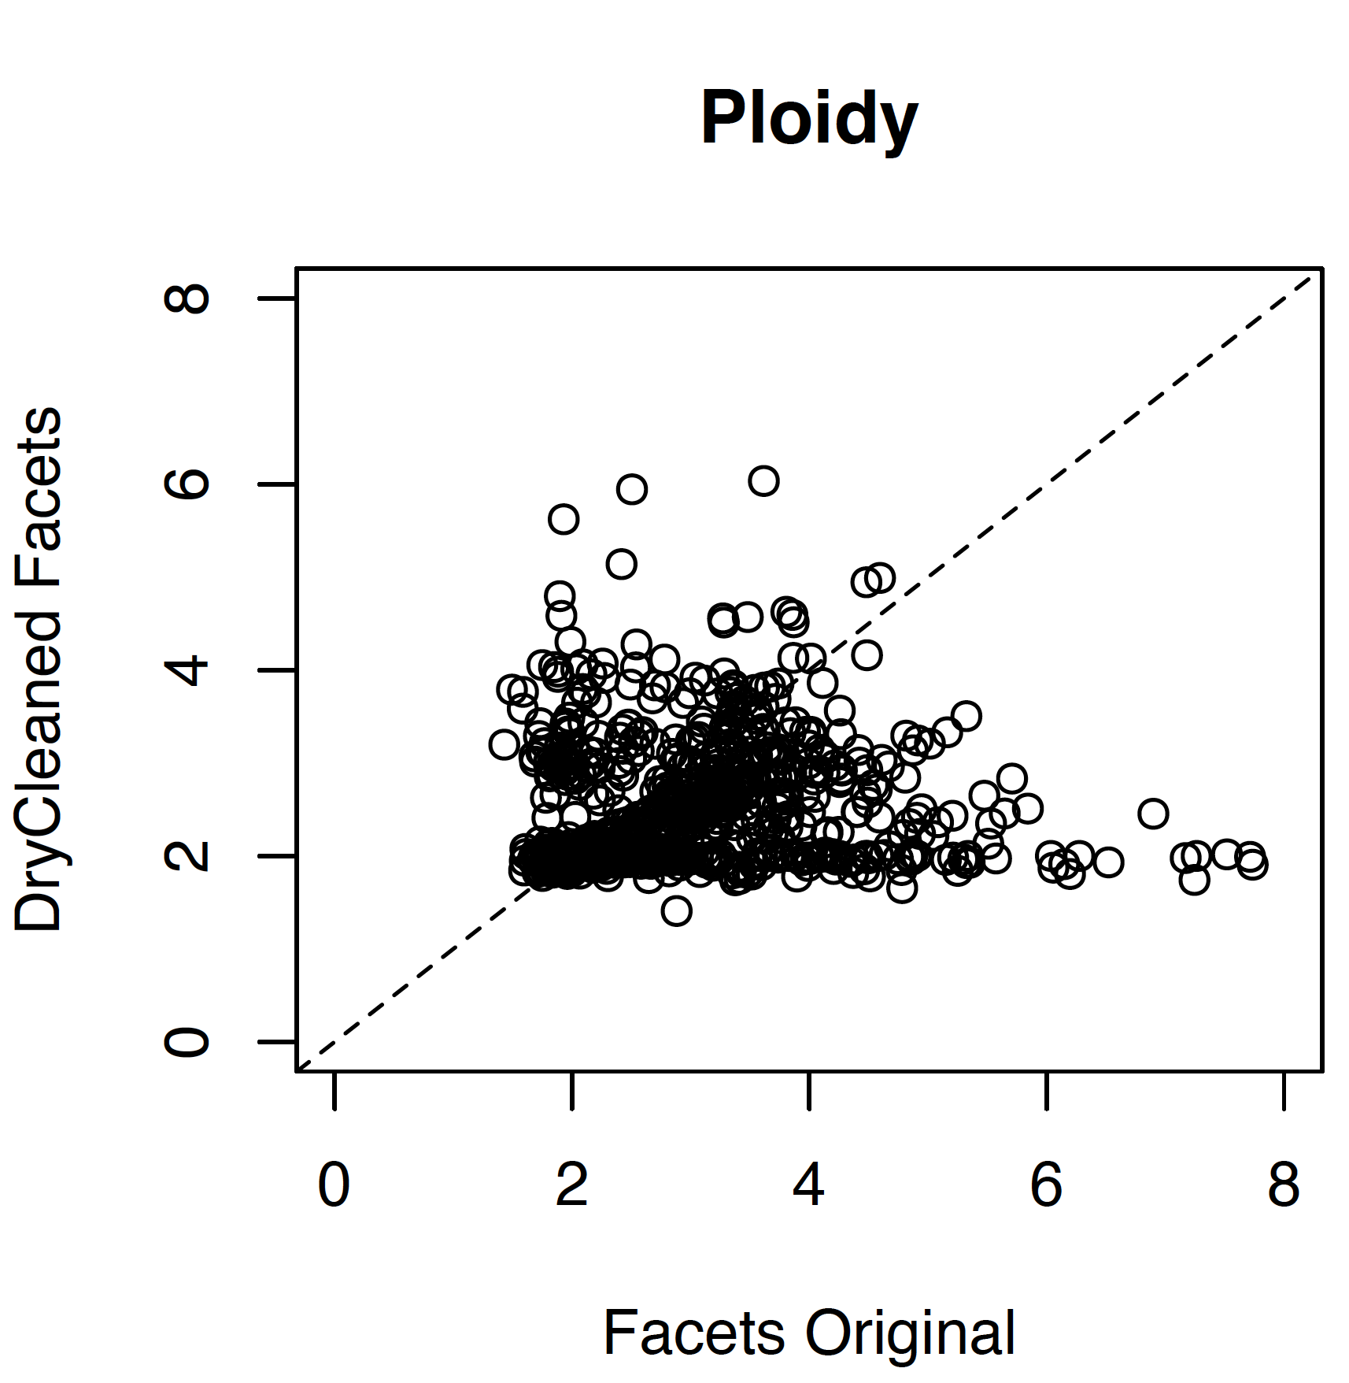
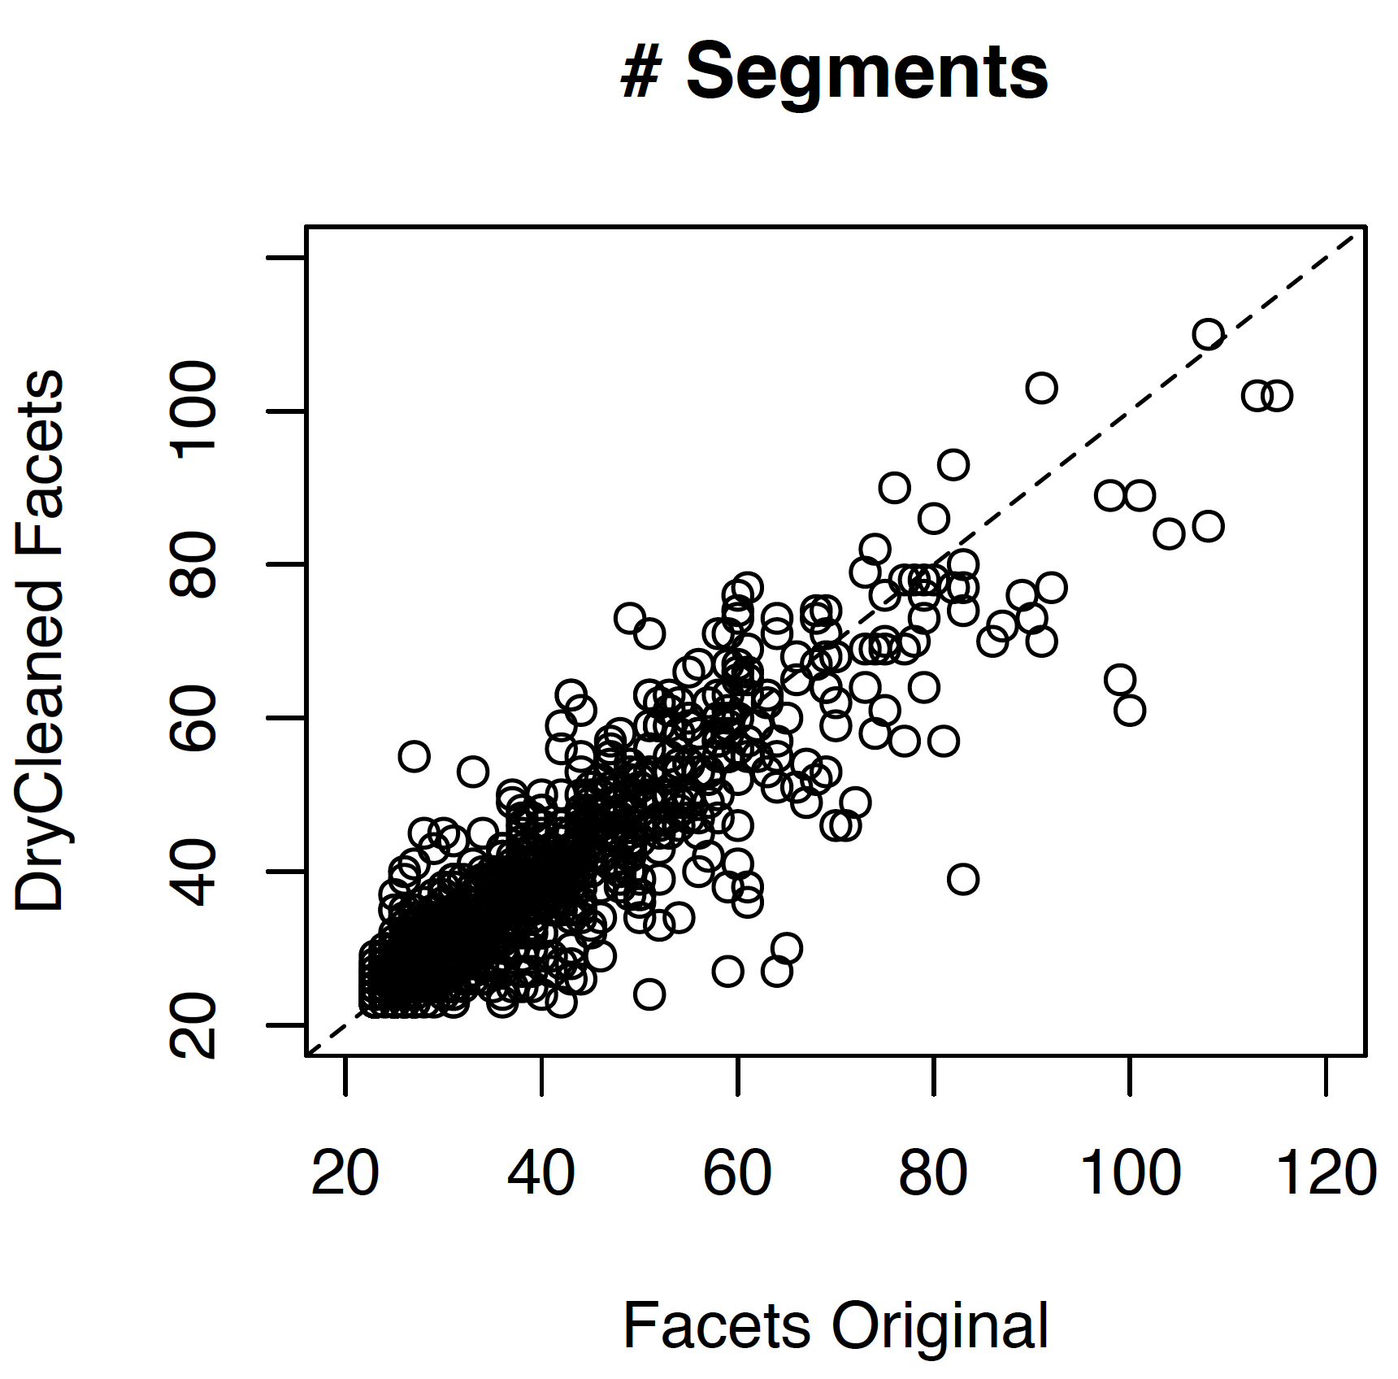
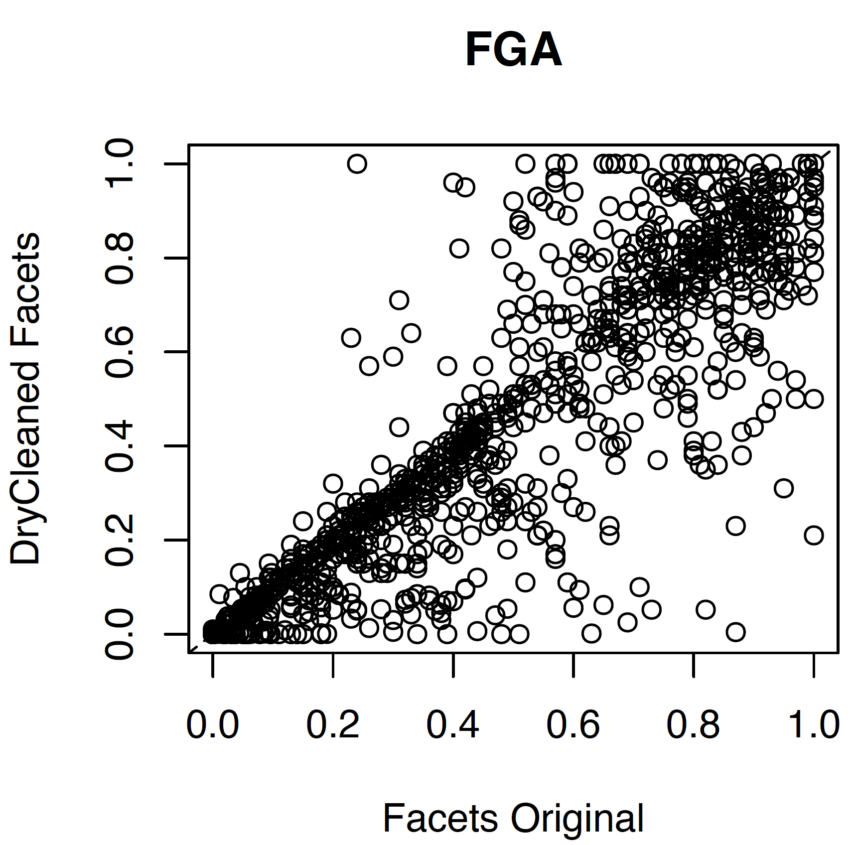
Reasonalbe correlation between original Facets and drycleaned-Facets: however, a 1:1 comparison is not meaningful per se
There are a lot of matches but also
mismatches (purity, #segs, etc.)
on a 1:1 sample comparison;
Recovery of ‘bad’ purity estimates – but
also loosing some
Since we cannot assess the true
estimates – either FACETS or
drycleaned-Facets we need a different
approach to assess the calls

Slide 12
Coming back to the power of Dryclean
One would expect a uniform seq coverage distribution of the normal samples;
We do know that this is not the case (eg GC content, mappability, replication waves, etc.)

Slide 13
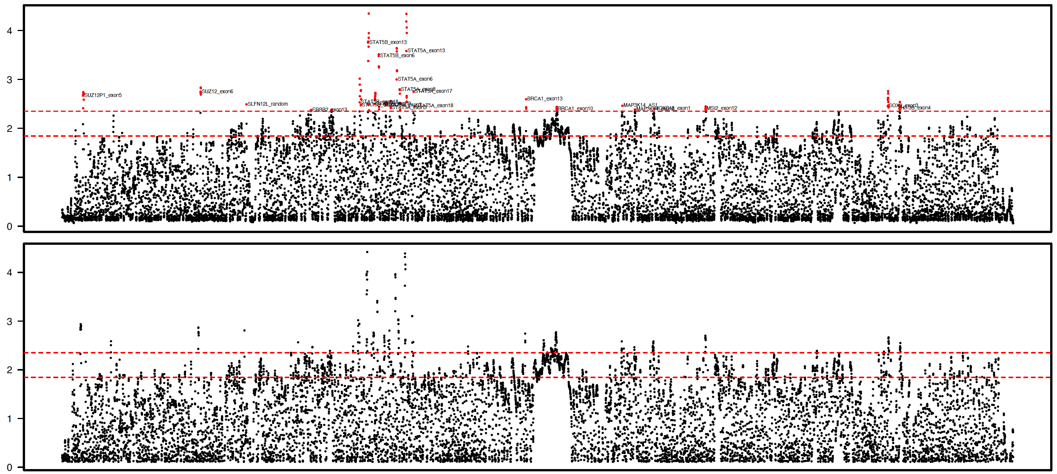
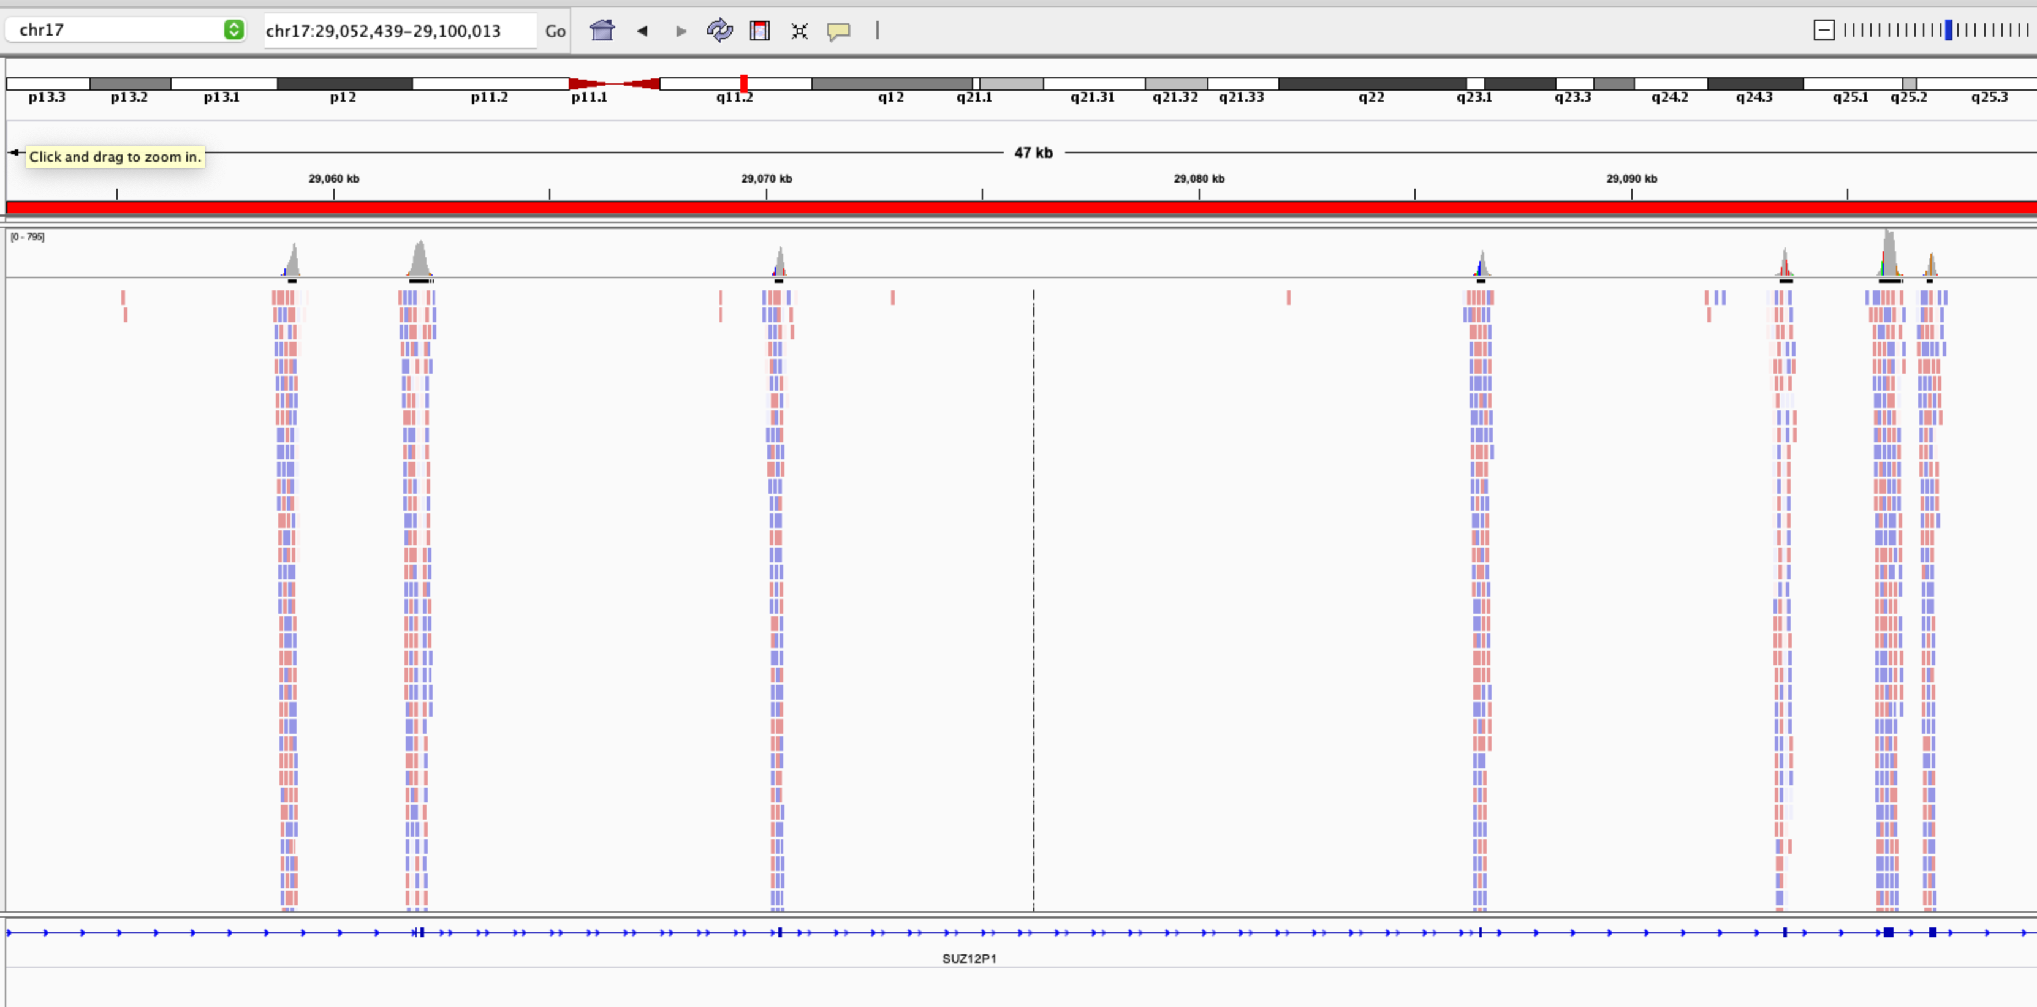
We see obvious noise
Population average
normals
SUZ12P1 = Pseudogene
Sample 1; Normal
normalized coverage

Slide 14
However, if we decompose the normals, are ‘noisy’ bins (slide before) flashed off?
Is there a chance we can use the detergent (L-matrix) to see the true signals across chromosome 17q - ideally, we want to see a uniform coverage across the whole genome

Slide 15
Addy
FACETS: cnlr = log2(1+rCountT*tscl) - log2(1+rCountN) - gcbias
Dryclean foreground.log (decomposed tumor) == FACETS: cnlr
Sending foreground.log into segmentation?
Or foreground

Slide 16
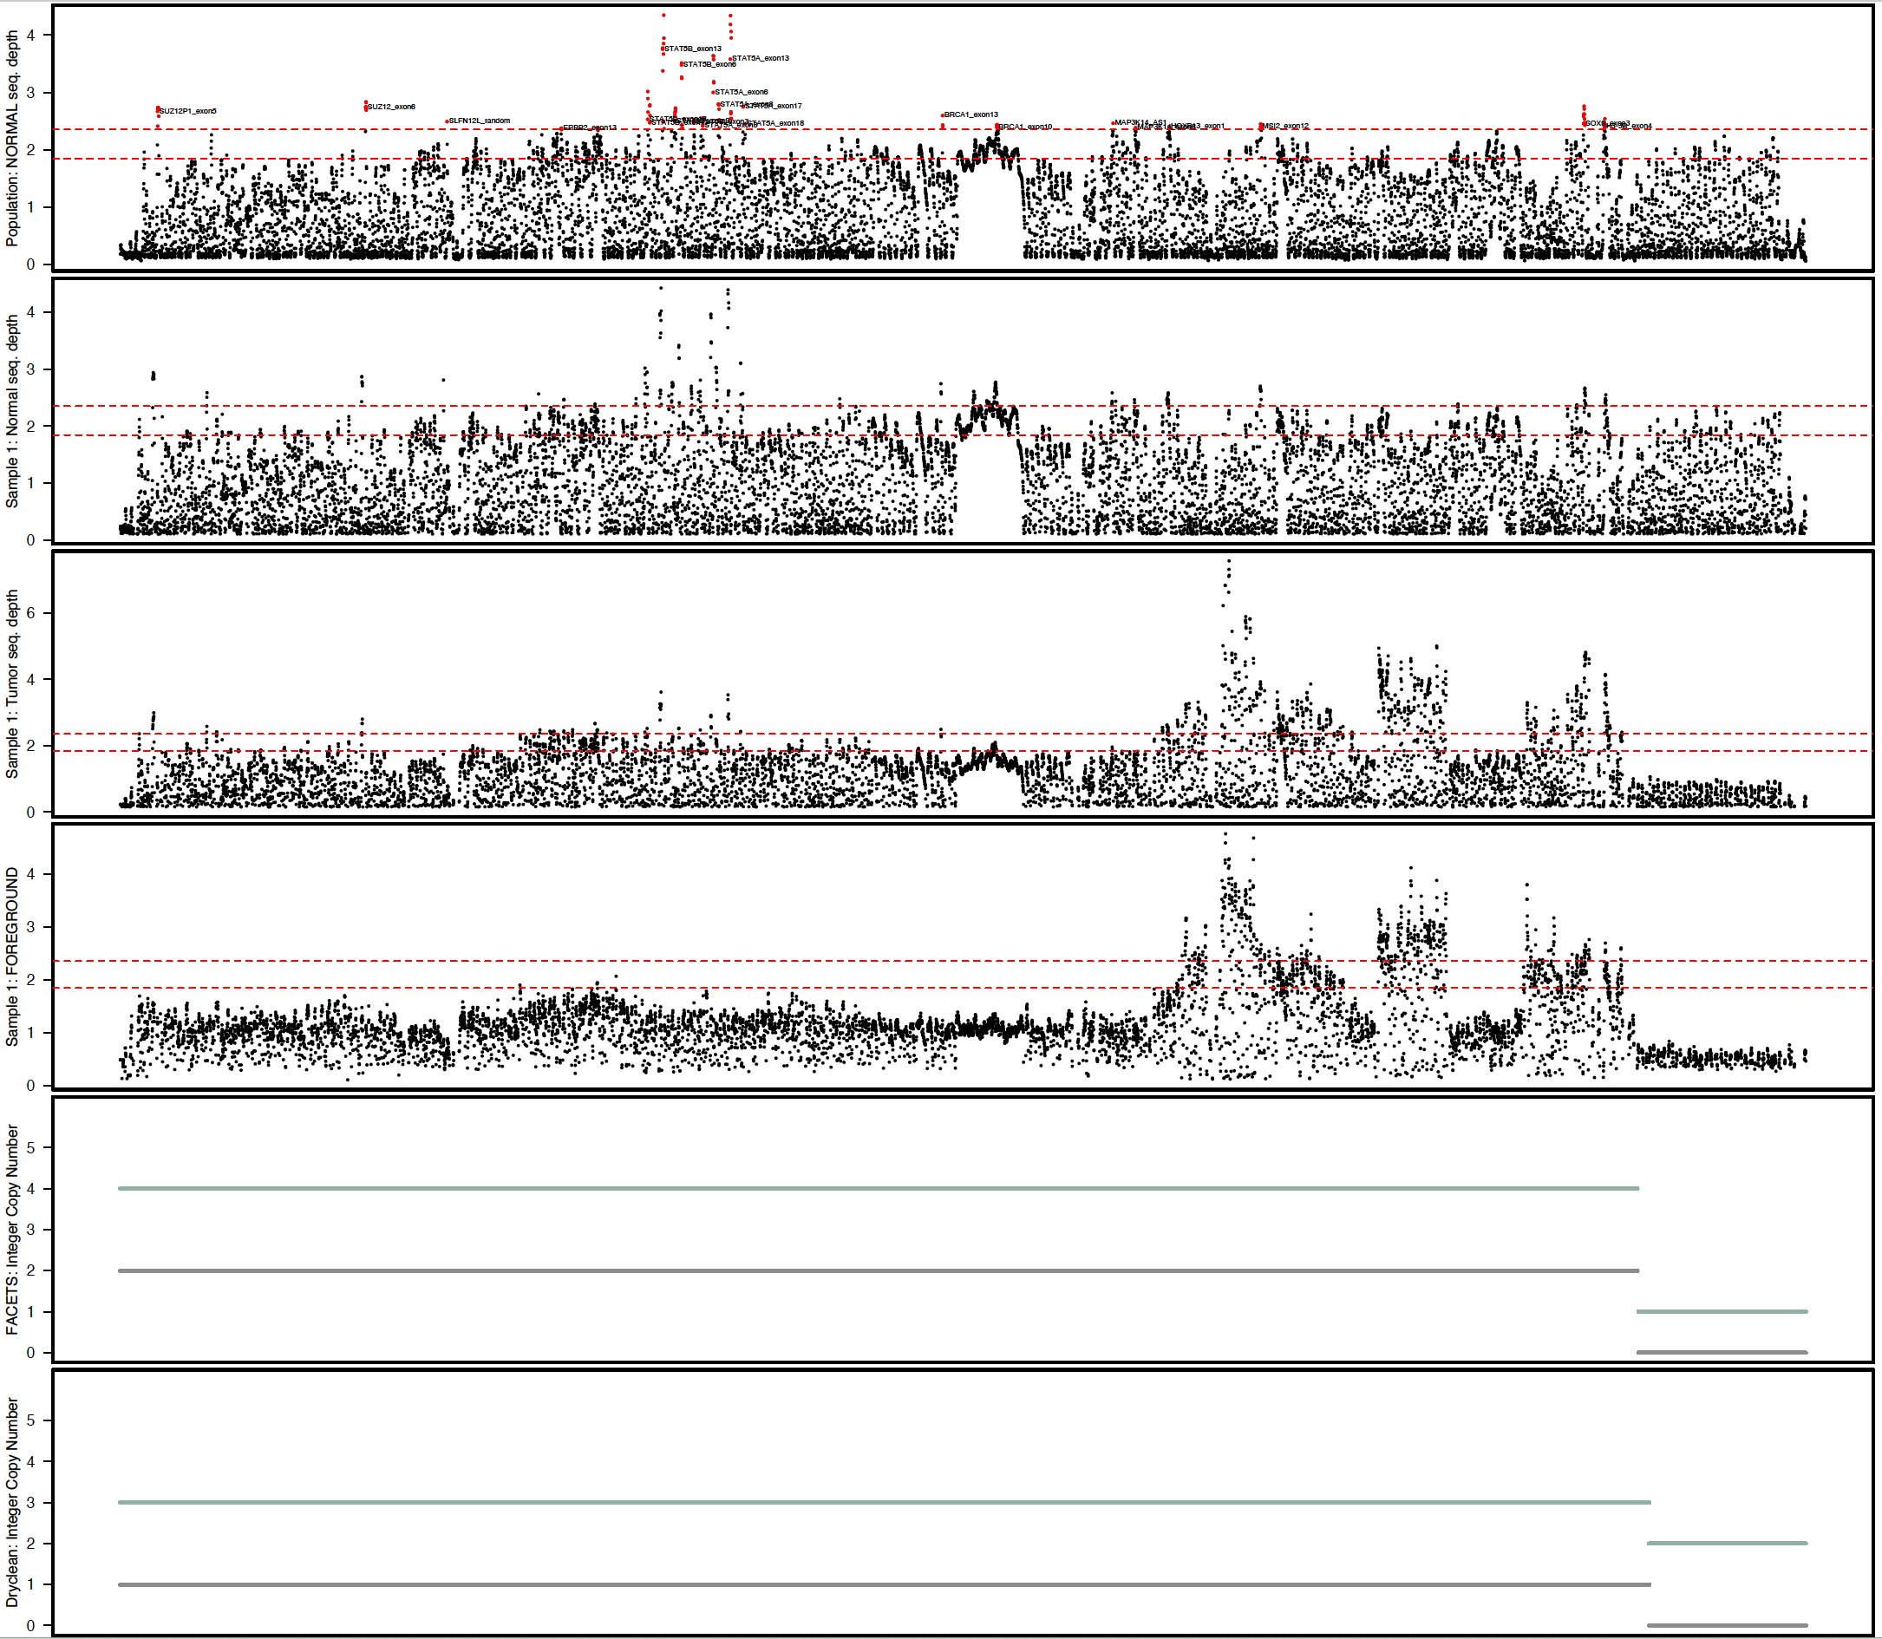
One example
FACETS:
balanced gain?
Dryclean
unbalanced gain?
Chr17q coordinates

Slide 17
Uneven seq. coverage in the normals
Noise?
Noise?
Chr17q: 26 targeted genes from IMPACT; 8 show elevated coverage
If there is uneveness in the normals (eg elevated coverage) the chance to call a loss in the tumor is higher

Slide 18
‘noise’ captured in the tumor as well?

Slide 19
Drycleans foreground seem to flash off the noise
Foreground =
T/N ratio
corrected for background?

Slide 20
Naïve expected copy numbers (T/N ratio)
Amp
Amp
euploid
(balanced)
Deletion
Amp
euploid
Deletion

Slide 21
Facets lumps events ‘together’
focal events
FACETS:
balanced gain?
Dryclean
unbalanced gain?
Chr17q coordinates

Slide 22
I think dryclean itself is doing a good job
noise widely flashed off

Slide 23
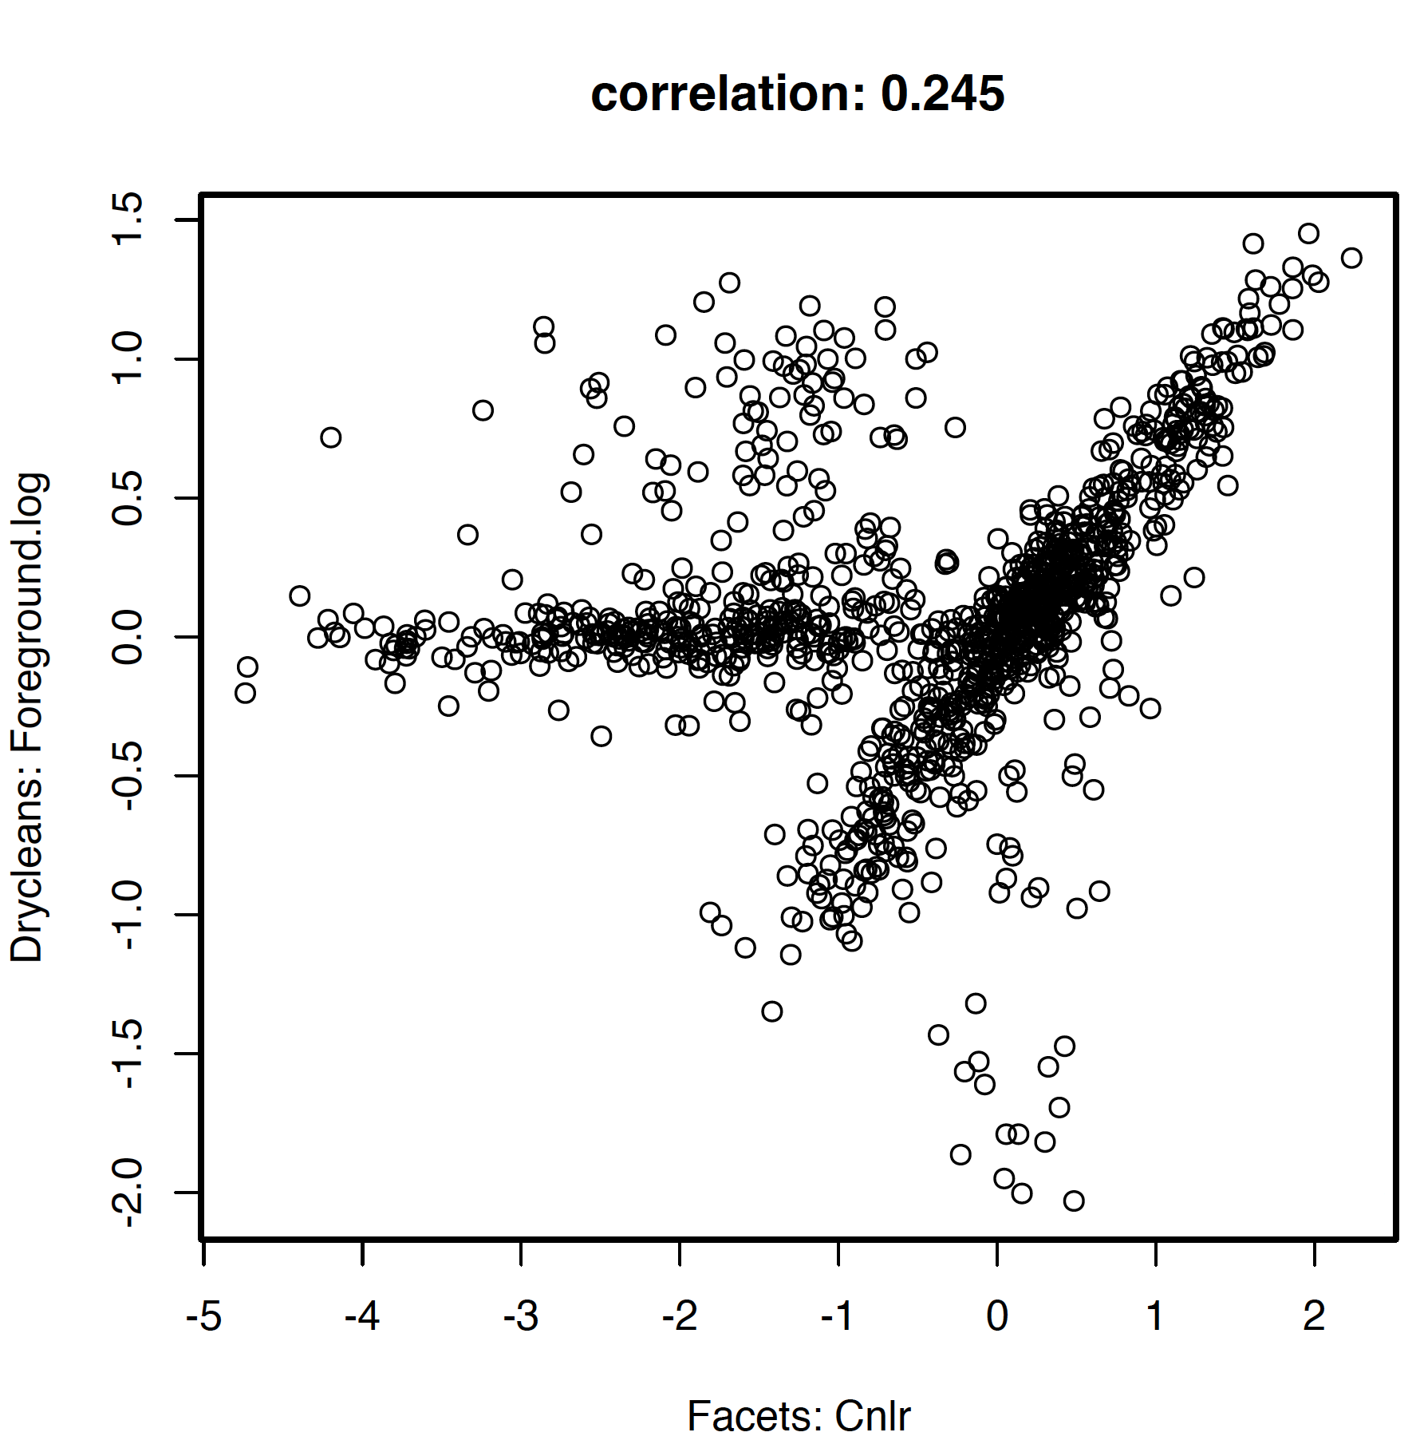
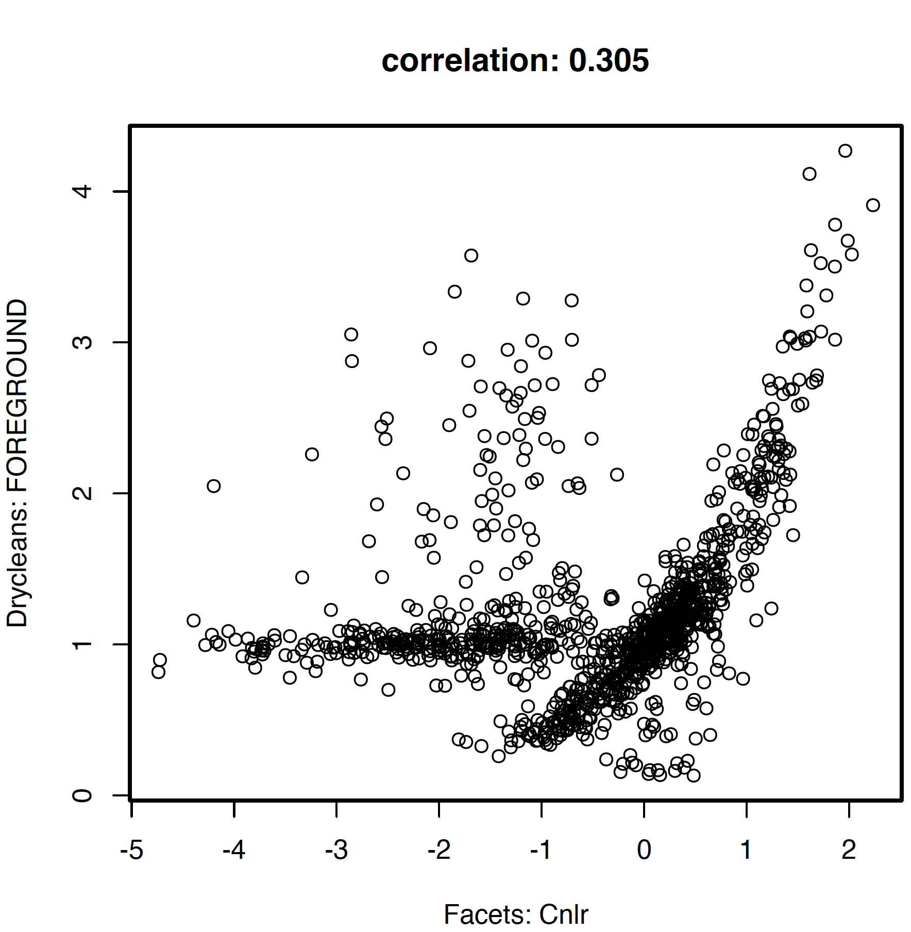
What’s going on with Facets?
We substitute Facets: cnlr with drycleans-foreground.log
Estimates are centered around 0

Slide 24
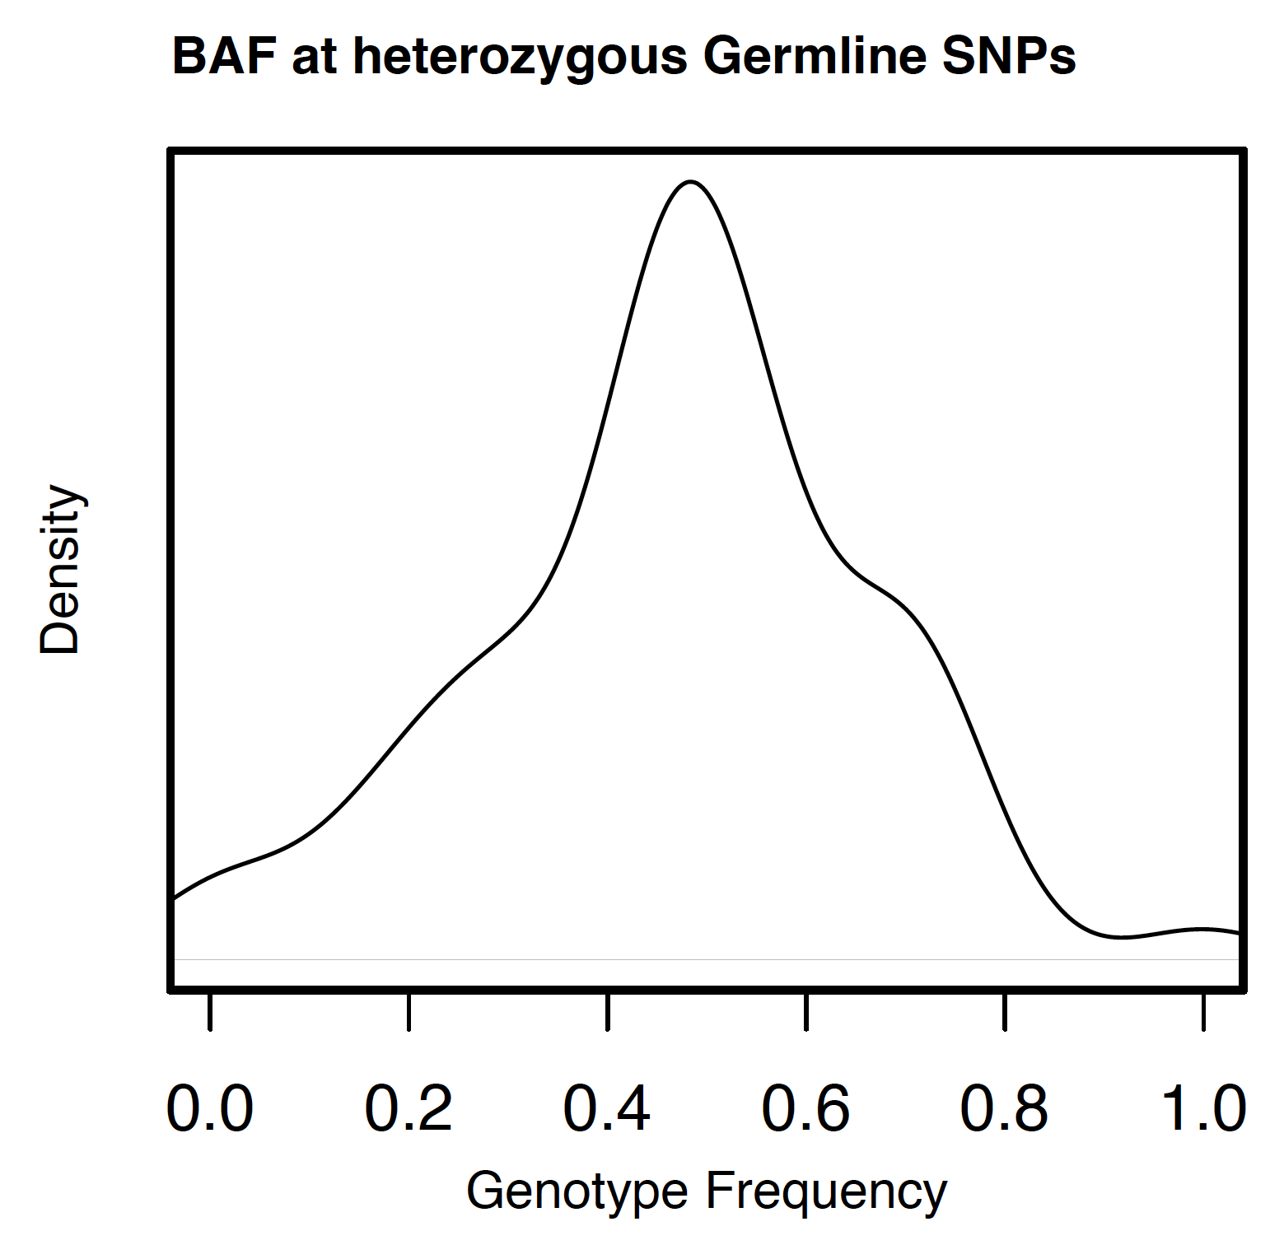
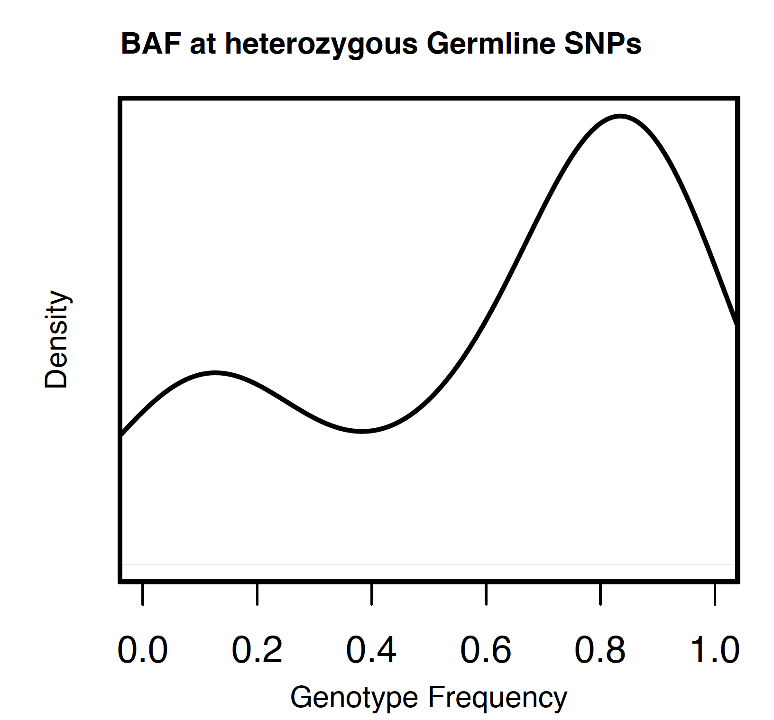
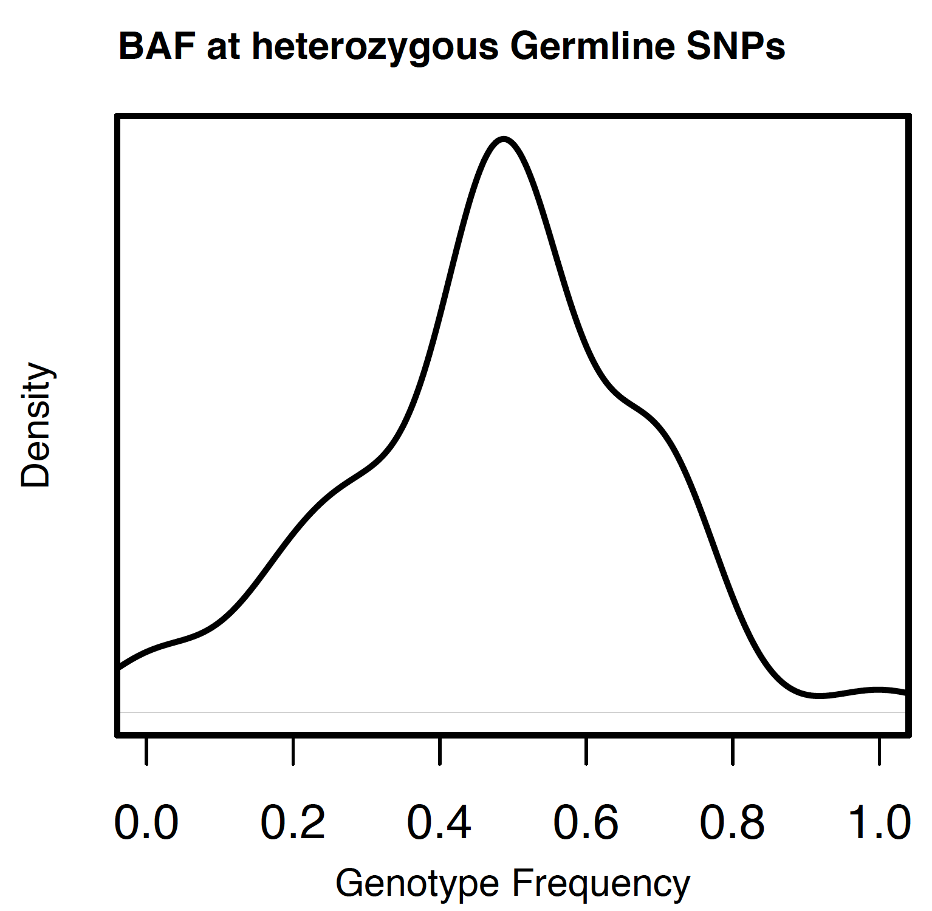
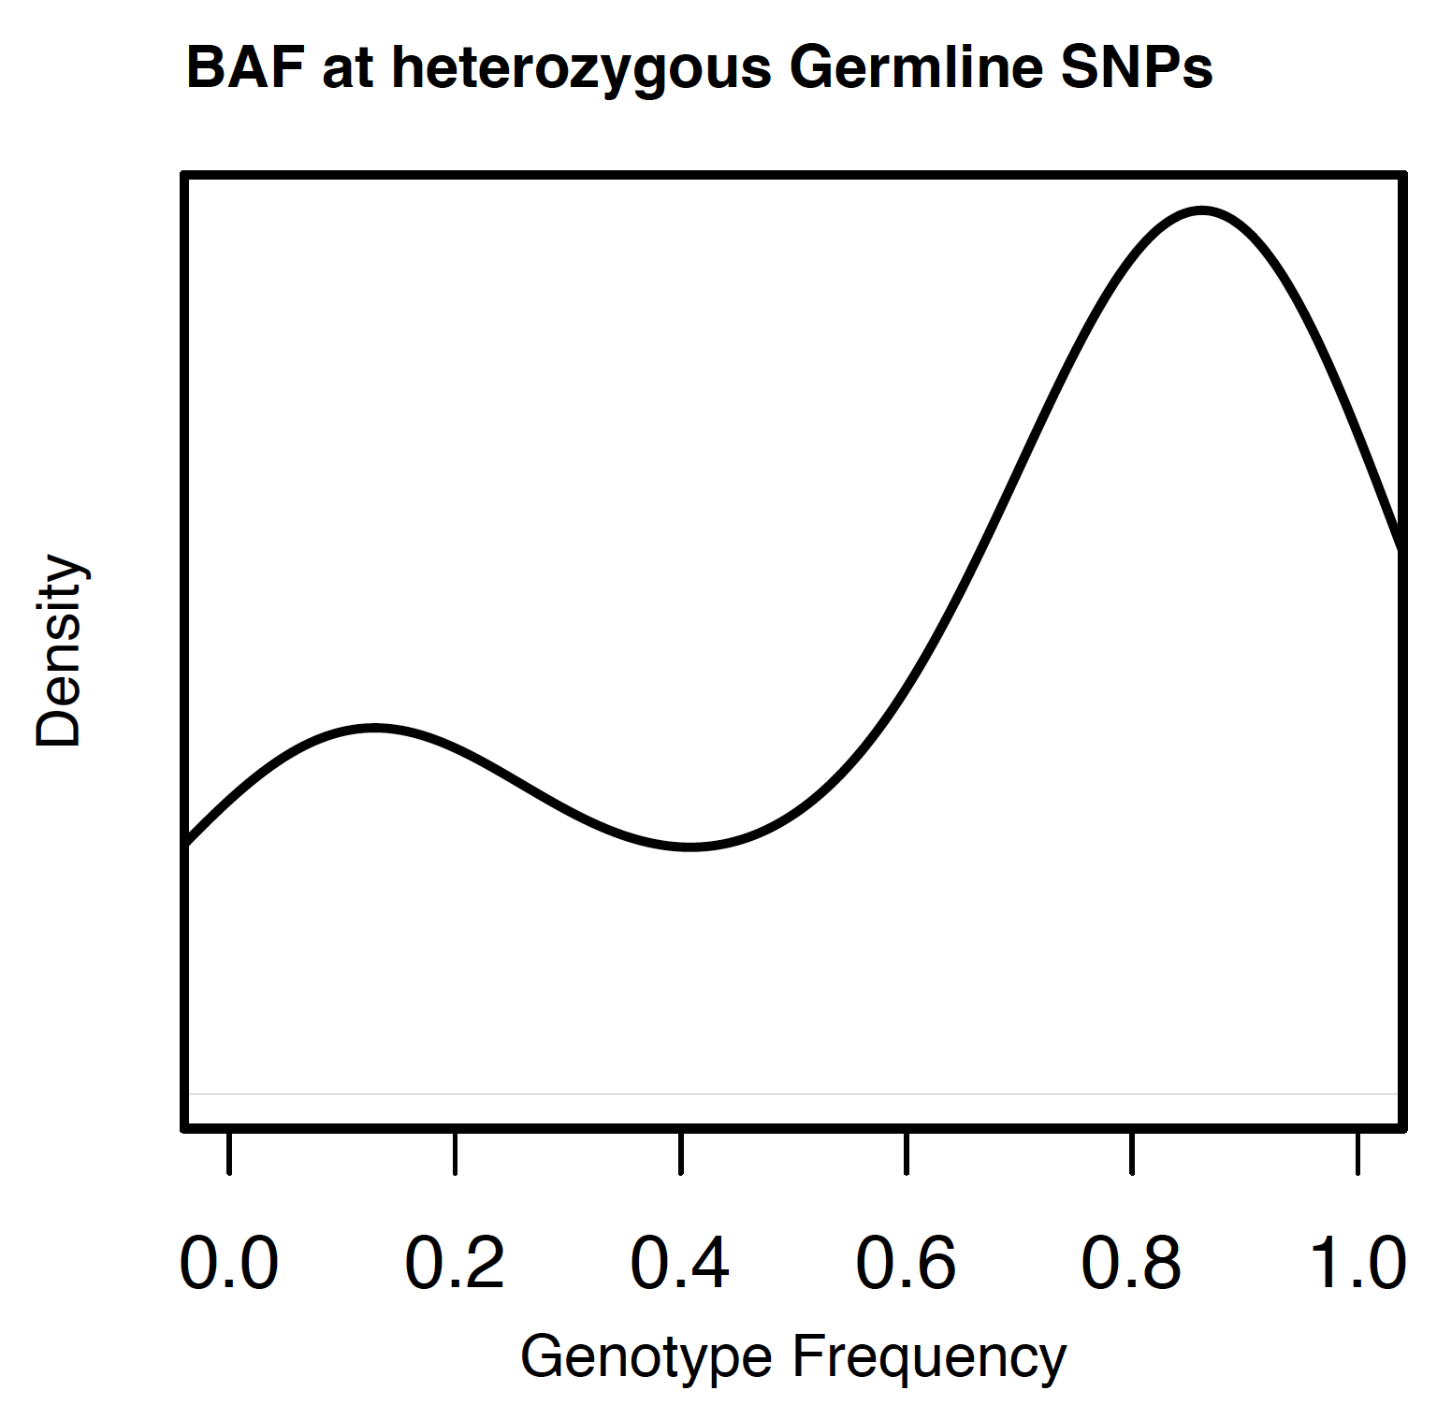
Coming back to the Integer copy number calls
FACETS:
balanced gain (4:2)?
FACETS:
LOH (1:0)?
Dryclean
unbalanced (3:1) gain?
Dryclean
CNLOH (2:0)
Heterozygous SNPs BAFs are basically untouched (substituted) in the Facets-pipeline

Slide 25
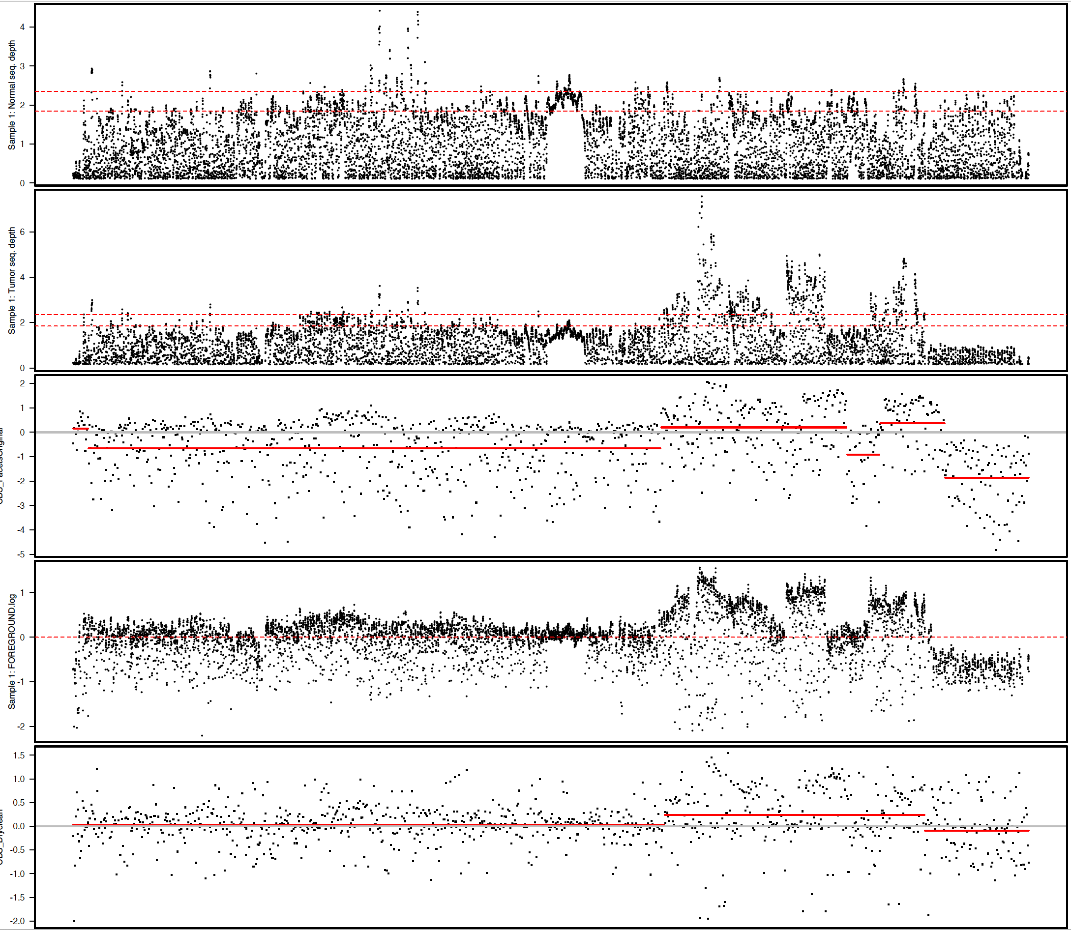
CBS – original Facets
naïve
T/N ratio

Slide 26
CBS-Dryclean foreground.log

Slide 27
Tuning cval and snp.nbdh

